Slide 1
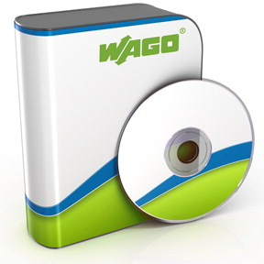

Software, Tools & Docs WAGO-I/O-SYSTEM
3
e!COCKPIT functionality
Create a project
Software overview
Configuration
I/O-CHECK

Slide 2
e!COCKPIT functionality
Configuration | „I/O-CHECK“
Programming | Visualization

Slide 3
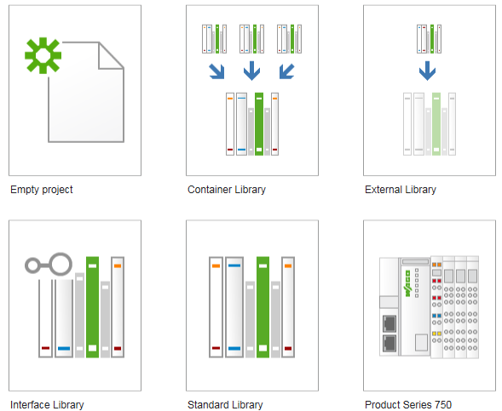

Create a project
You can start a project either at Empty project or
Product Series 750.

Slide 4
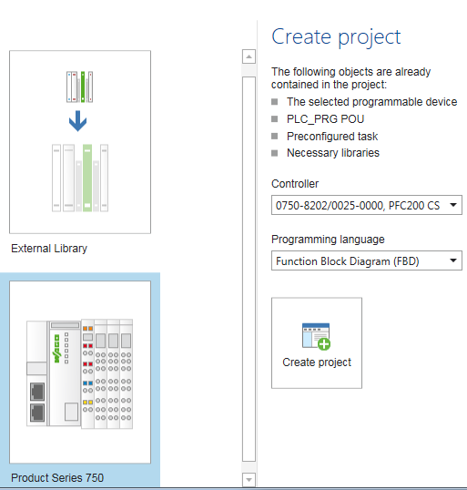
Create a project
Empty project:
Preferably, in online configuration or more controllers in the project.
Product Series 750:
Preferably, in offline configuration with 1 controller/ project.

Slide 5
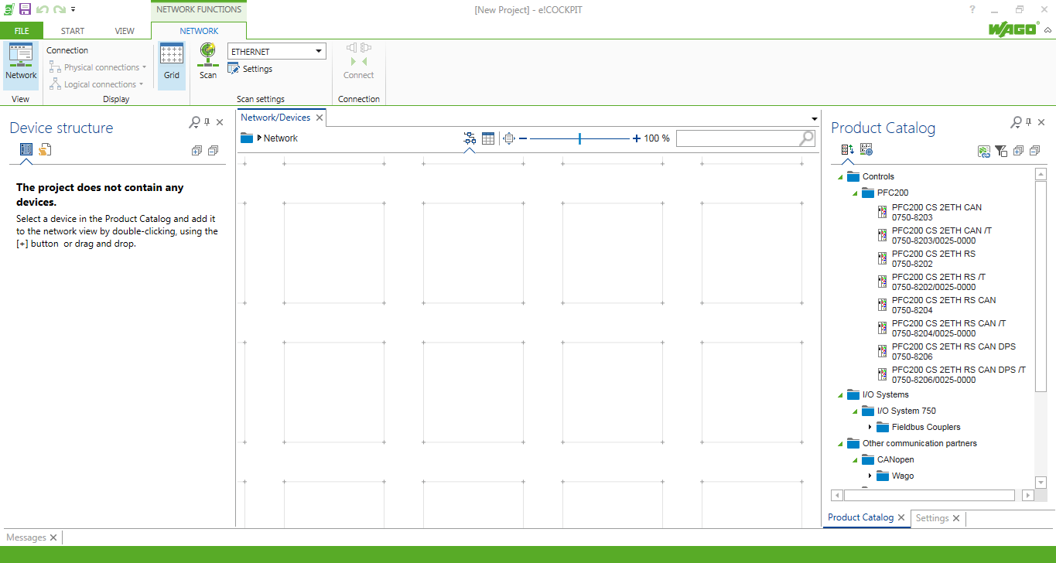
Software overview
After creating an empty project e!COCKPIT starts in the graphical Device structure.

Slide 6
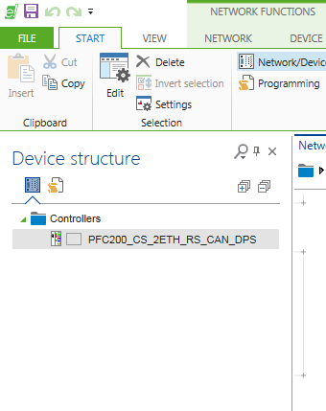
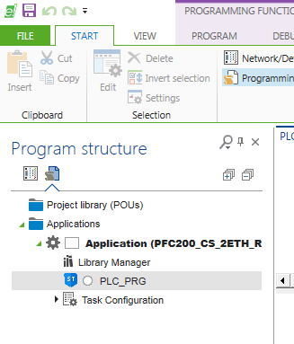
Device structure – Program structure
You can switch between the Device structure and Program structure with symbols on the left side of the screen
Device structure
Program structure

Slide 7
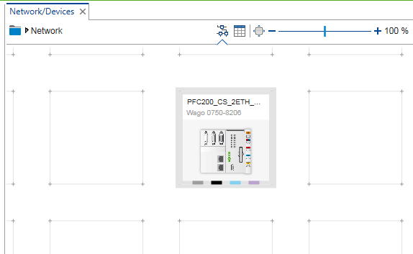
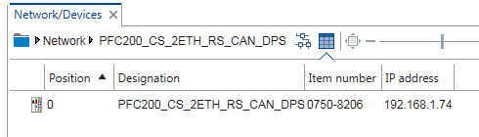
Alternative Device structure views
Graphical view
Table view

Slide 8
Configuration steps in e!COCKPIT
Configure network
Configure network nodes
Online
Offline
Configure node modules (if necessary)
Configure variables
configuration
network
Online
devices
modules
Offline
devices
modules
variables

Slide 9
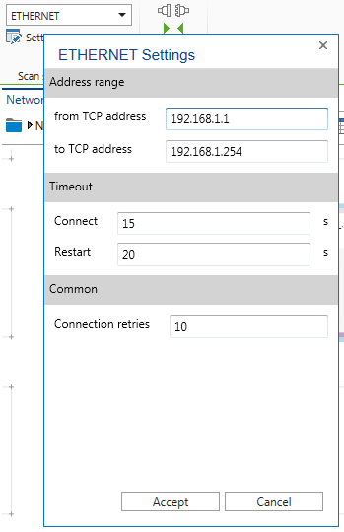
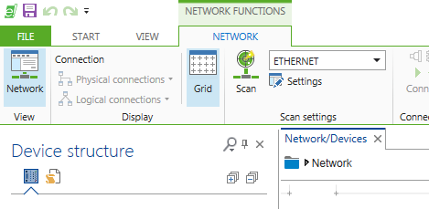
Configure network
Adjust the ETHERNET network settings according to your IP address range
IP network settings

Slide 10
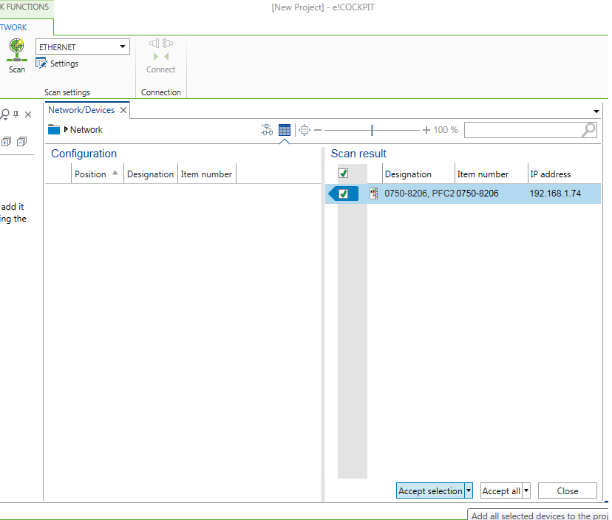
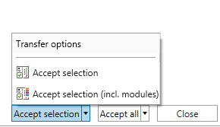
Online node configuration
Scanning the devices
Two options
Configured and scanned device agree
New device is detected

Slide 11
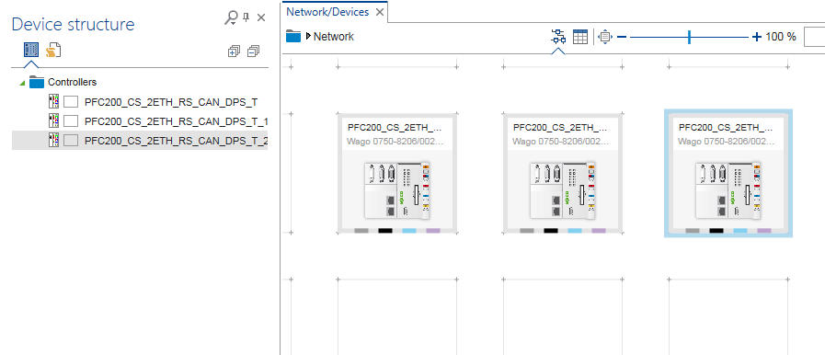
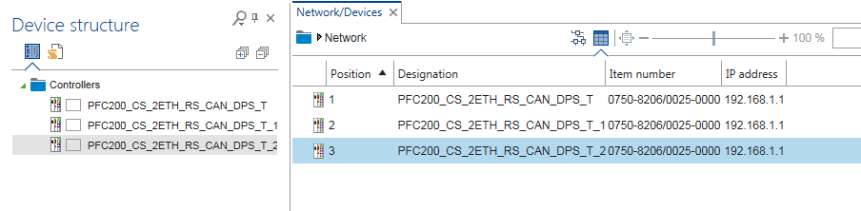
Online node configuration
Configuration with controllers and modules
Graphical view
Table view

Slide 12
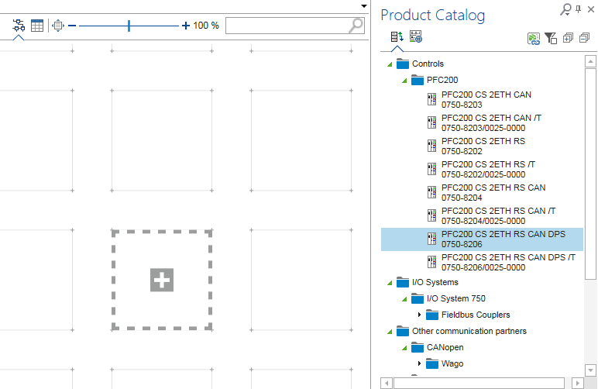
Offline node configuration
Insert devices from product catalog

Slide 13
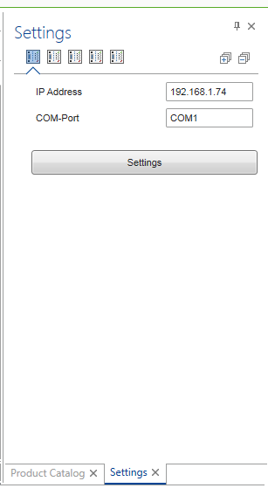
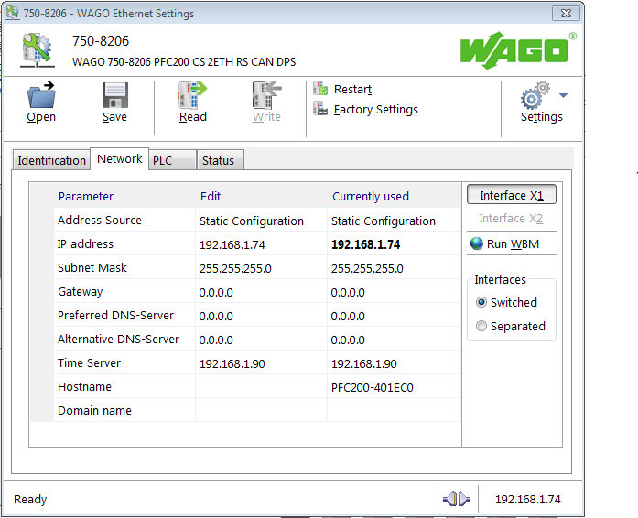
Offline node configuration
1st option: Set the communication parameters
If Communication parameters are set correctly, you can read controller settings via Ethernet Settings

Slide 14
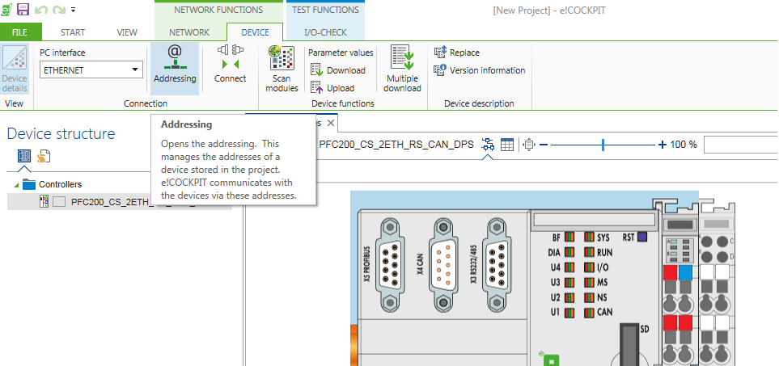
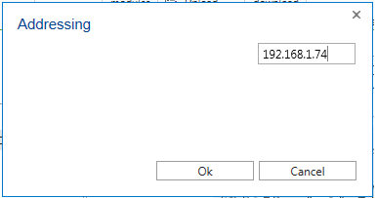
Offline node configuration
2nd option: Set the communication parameters
In Menu =>Device =>Addressing

Slide 15
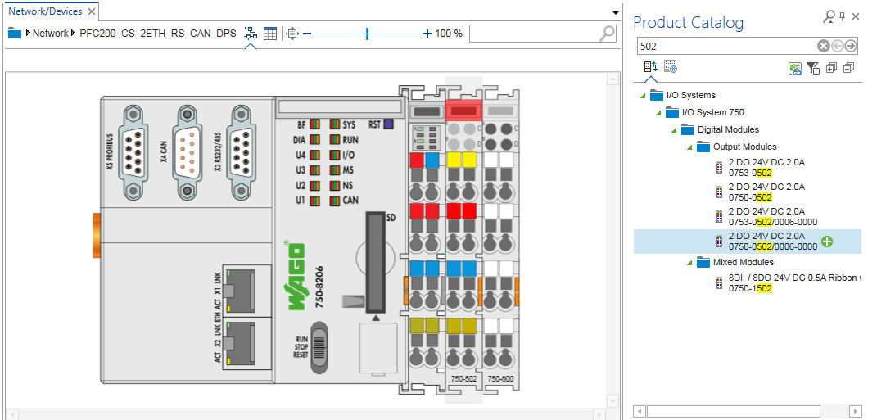
Offline node configuration
Insert the modules from the product catalog

Slide 16
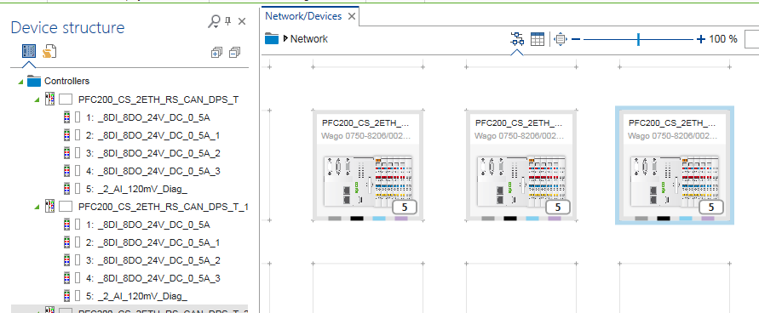
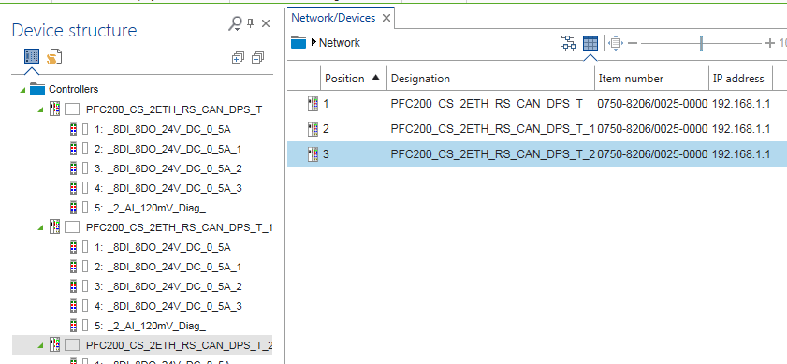
Offline node configuration
Configuration with controllers and modules
Graphical view
Table view

Slide 17
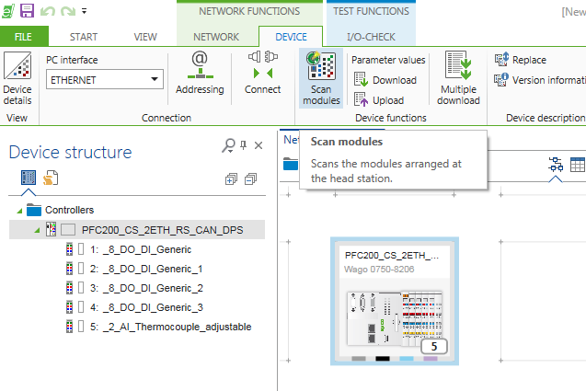
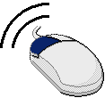
Configure variables
After Scan devices => Scan modules

Slide 18
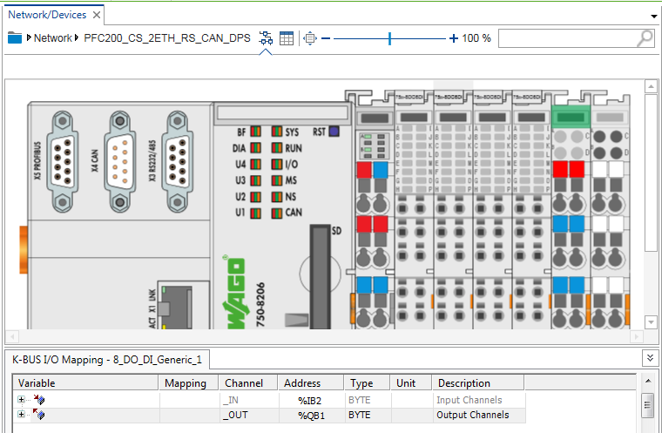
Configure variables
slide upwards

Slide 19
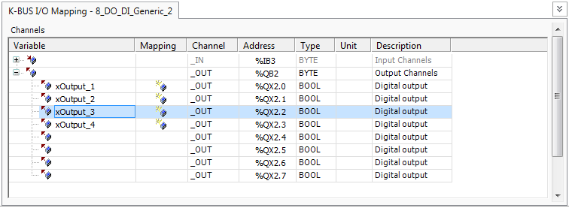
Configure variables
Type in the variables name of inputs and outputs
Digital modules can be addressed in word/ byte or in bit.
For outputs only alternatively and not at the same time.

Slide 20
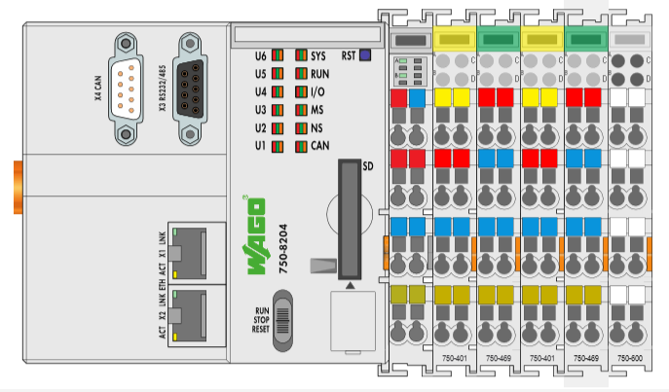
Configure variables
%I, %Q process image of addressing scheme (example)
Byte | Word
%IB0 couple %IW0
%IB1 digital module1
%IB2 | %IW1analog module1_1
%IB3
%IB4 | %IW2 analog module1_2
%IB5
%IB6 digital module2 | %IW3
%IB7 (empty)
%IB8 | %IW4 analog module2_1
%IB9
%IB10 | %IW5 analog module2_1
%IB11
%IB0
IB1
IW1
IB6
IW4
Due to this overlap of %IB and %IW areas, using this addressing is not recommended. Additionally, are changed the I%,%Q addresses for subsequent in the nodes configuration.

Slide 21
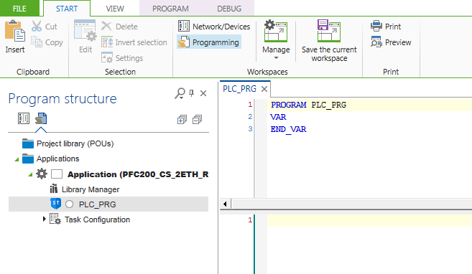
Write a simple program
Open Program structure

Slide 22
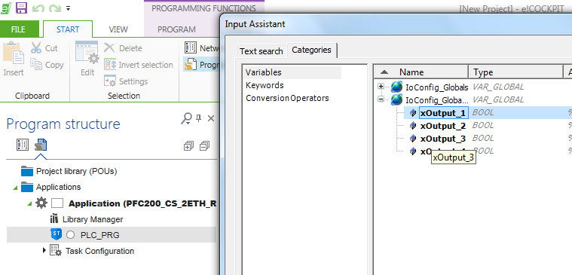
Write a simple program
Write a simple program (click in PLC_PRG and press the F2 button to get the configured variables

Slide 23
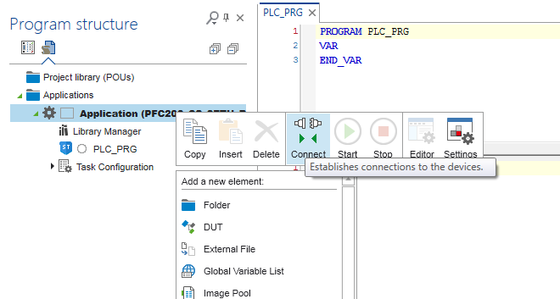

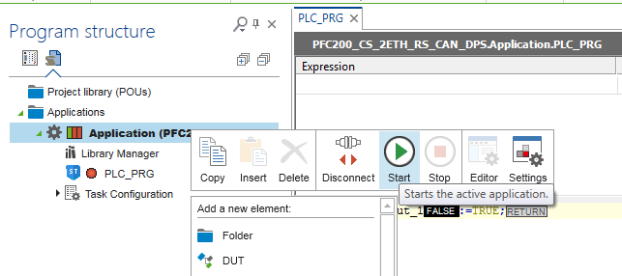
Write a simple program
Connect and Start

Slide 24
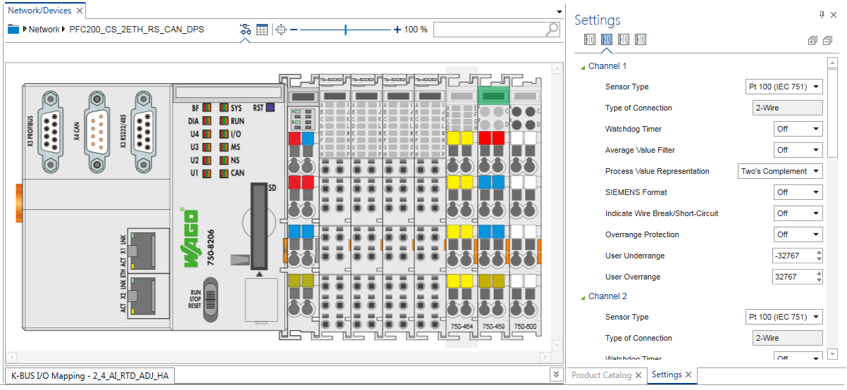
Module configuration
Additionally, some modules can be configured at settings (eg. 750-464).

Slide 25
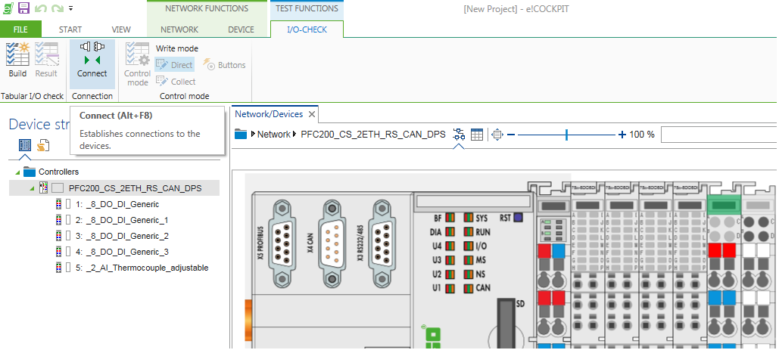
I/O-CHECK
I/O-CHECK control mode disabled: Inputs can be read
I/O-CHECK control mode enabled: Inputs can be read, outputs can be set
Control mode is only available, if PLC in STOP.

Slide 26
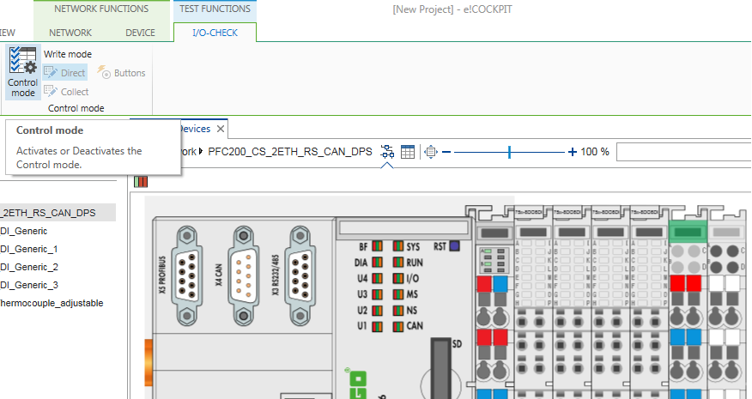
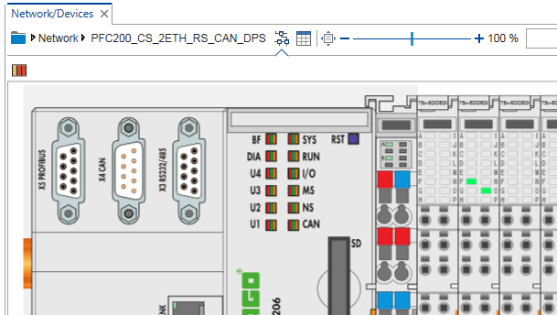
I/O-CHECK
How to read inputs and to set outputs
I/O-CHECK in control mode
To set outputs in I/O-CHECK click on the LED symbol
Control mode indicating color

